Slide 1
MIDI

Slide 2
What is MIDI?
MIDI stands for Musical Instrument Digital Interface
Some Clarification:
MIDI doesn’t directly describe musical sound
MIDI is not a language
It is a data communications protocol

Slide 3
History of MIDI
1900s: electronic synthesizers developed
1970s: digital synthesizers developed
Each manufacturer used different design scheme, with their own keyboard / panel
At that time, synthesizers were monophonic
With a particular input device, each player can only run one or two synthesizers at the same time
To use a wide range of synthesized sounds, many players were needed

Slide 4
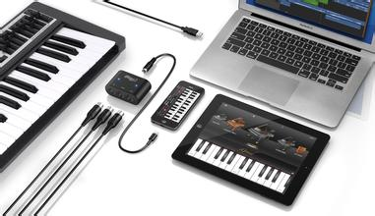
Electric Music and MIDI
What is MIDI?
MIDI (Musical Instrument Digital Interface): a technology to synthesize music using electronic equipment.
MIDI Standards
An industry-standard that enables electronic musical instruments, computers and other electronic equipment to communicate and synchronize with each other.
2-<number>
Notes:
MIDI is a way of telling a device capable of MIDI playback to play the right notes in the right order.
An industry-standard protocol that enables electronic musical instruments, computers and other electronic equipment to communicate and synchronize with each other.
《多媒体技术及应用》
第2章 多媒体音频技术

Slide 5
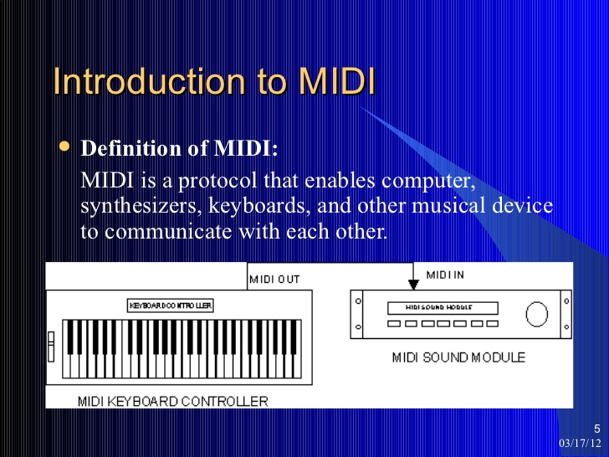

Slide 6
MIDI Protocol (language)
The MIDI protocol is an entire music description language in binary form like CPU machine language instructions for musical instruments. .
MIDI language carries event messages that specify notation, pitch and velocity, control signals for parameters such as volume, vibrato, and etc.
2-<number>
Notes:
An industry-standard protocol that enables electronic musical instruments, computers and other electronic equipment to communicate and synchronize with each other.
These messages can be sent via a MIDI cable to other devices where they control sound generation and other features.
A MIDI file is not a recording of actual audio.it symbolically represents a note (i.e., "A4"), whereas digital audio represents the sound produced by the note. So it use a thousand times less disk space than the equivalent recorded audio.
MIDI sequences can be manipulated in ways that prerecorded audio cannot. It is possible to change the key, instrumentation or tempo of a MIDI arrangement,and to reorder its individual sections.
《多媒体技术及应用》
第2章 多媒体音频技术

Slide 7
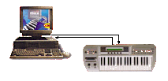

MIDI Working Progress
Sound Card
MIDI Instrument
MIDI Interface
Synthesizer
Loudspeaker
Sequencer
MIDI File
PC
There are actually three components in MIDI standard, which are the communications Protocol (language), the Connector (hardware interface) and a distribution format called Standard MIDI Files.
2-<number>
Notes:
Sequencer is the key component for MIDI music creation.
A music sequencer (or simply sequencer) is a device or application software that can record, edit, or play back music, by handling note and performance information in several forms, typically MIDI,
This MIDI data can also be recorded into a hardware or software device called a sequencer, which can be used to edit the data and to play it back at a later time
《多媒体技术及应用》
第2章 多媒体音频技术

Slide 8
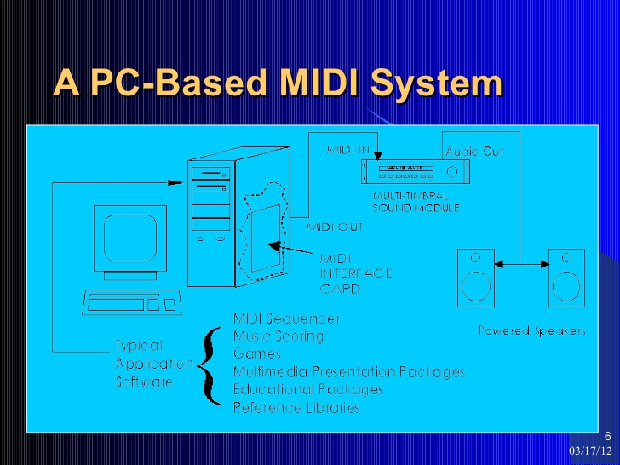

Slide 9
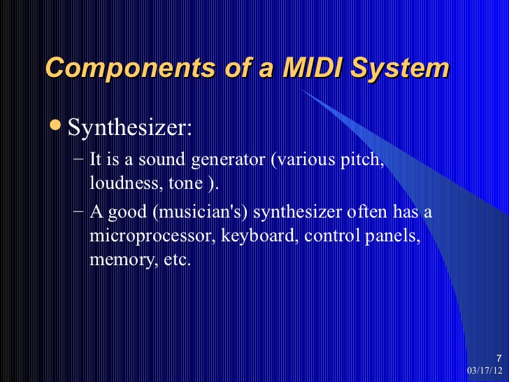

Slide 10
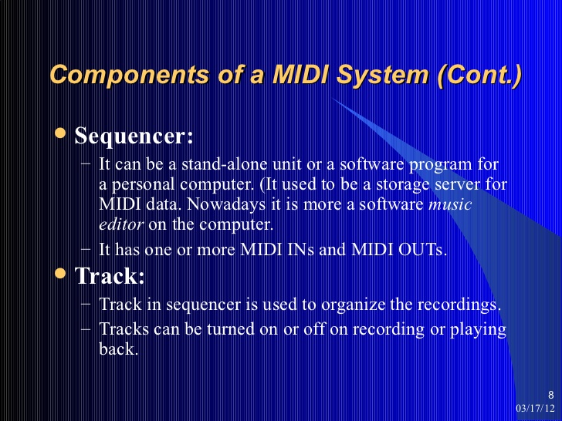

Slide 11
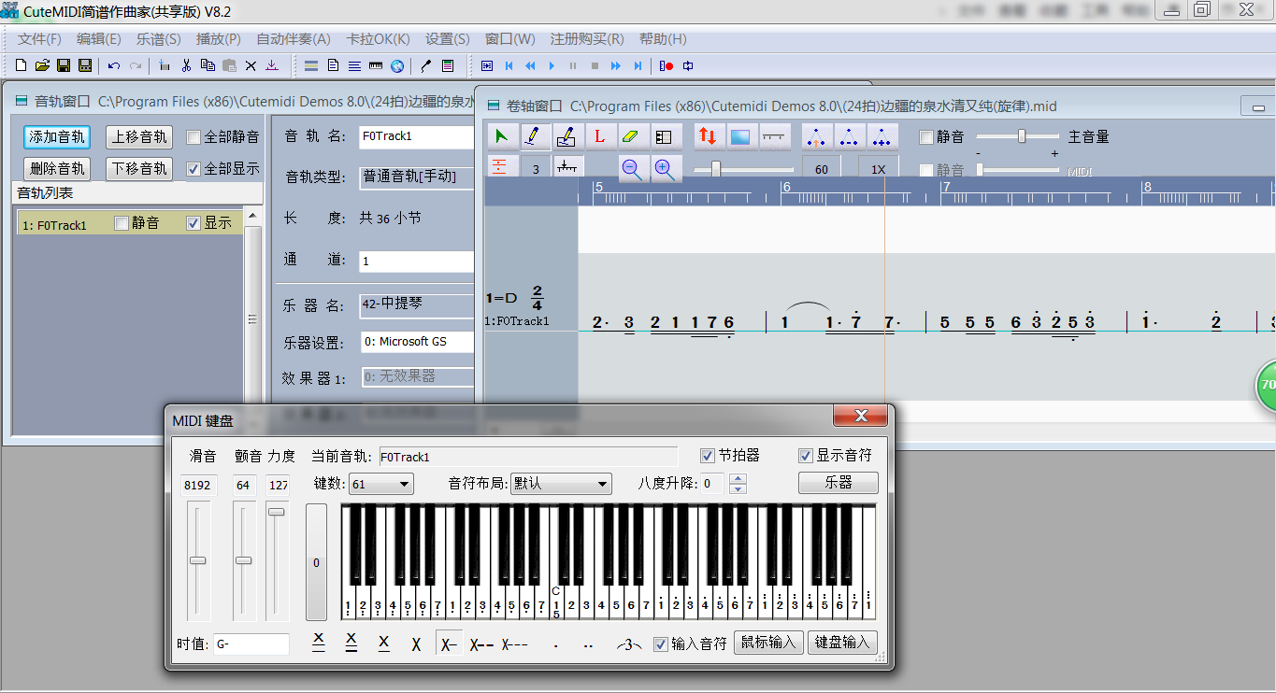
MIDI Synthesizer
Synthesizer is the key component for MIDI music creation.
A MIDI Synthesizer (or simply sequencer) is a device or application software that can record, edit, or play back music, by handling note and performance information in MIDI
2-<number>
Notes:
Sequencer is the key component for MIDI music creation.
A music sequencer (or simply sequencer) is a device or application software that can record, edit, or play back music, by handling note and performance information in several forms, typically MIDI,
This MIDI data can also be recorded into a hardware or software device called a sequencer, which can be used to edit the data and to play it back at a later time
《多媒体技术及应用》
第2章 多媒体音频技术

Slide 12
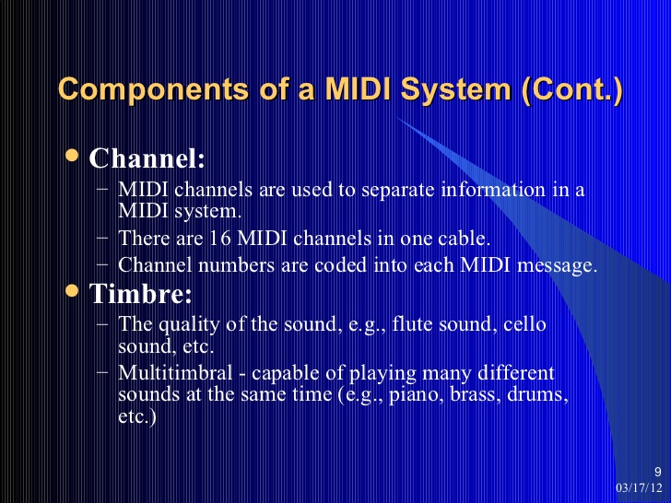

Slide 13
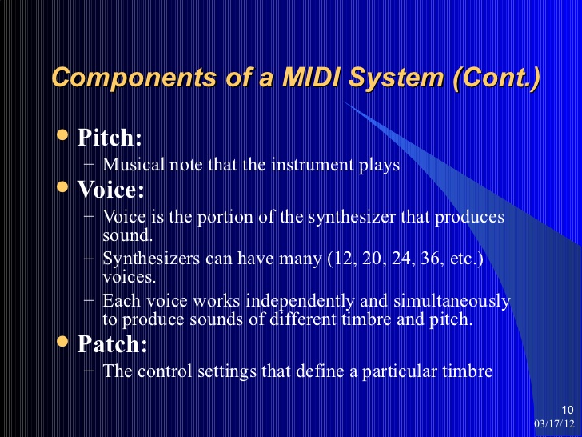

Slide 14
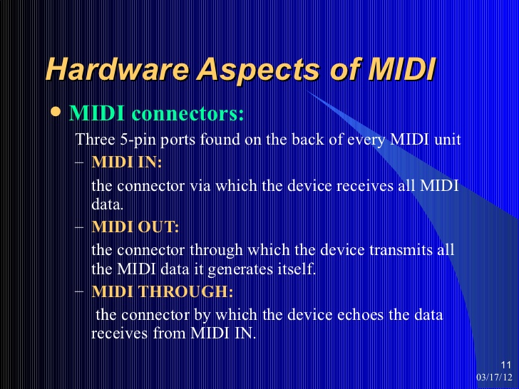

Slide 15
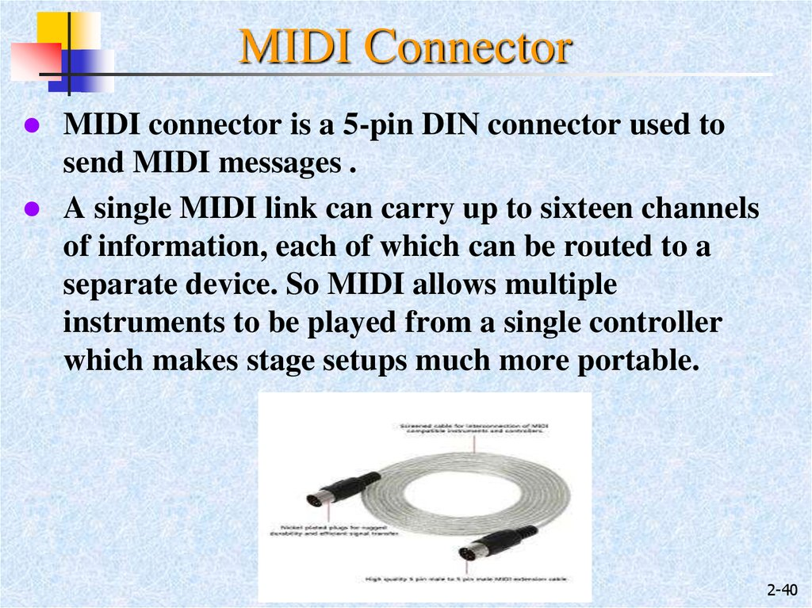

Slide 16
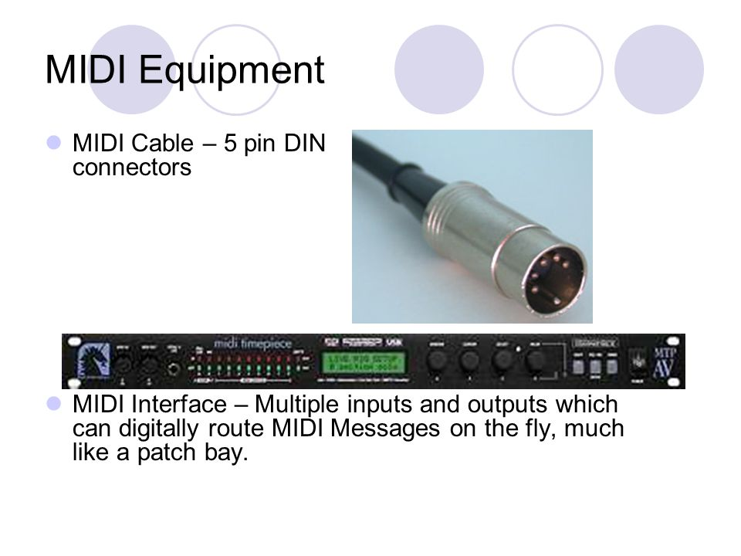

Slide 17
MIDI Interface
MIDI In
MIDI data enters each item of MIDI equipment through the MIDI In port.
MIDI Out
All the MIDI data generated by individual pieces of equipment are sent out through the MIDI Out port.
→A common error for MIDI setup is: inverted connection of MIDI IN/OUT
MIDI Thru
These are used to re-transmit all information received at the MIDI In port using the MIDI Thru port connections.
Often these ports are used to create a chain of connected devices in a single MIDI data path, called a 'daisy chain'.

Slide 18

MIDI Ports
It use a five-pin DIN connector
  Inexpensive and readily available
  Only 3 pins among 5 are used until now
  Both ends of MIDI line are the same.

Slide 19
MIDI Ports
Serial transfer, data are sent bit by bit
Hence:
- transmission rate is slow at only 31,250 bits/sec.
- Too slow to transmit samples in real-time
- have to do off-line sample dump

Slide 20
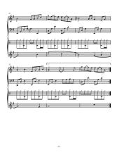
MIDI File
When MIDI messages are stored on disks, they are commonly saved in the Standard MIDI file format.
MIDI file does not contain the actual sound, but only commands(like musical notation) to make the sounds, so it use a thousand times less disk space than the equivalent recorded audio.
Example: midi_sample.mid
Notes:
These messages can be sent via a MIDI cable to other devices where they control sound generation and other features.
A MIDI file is not a recording of actual audio.it symbolically represents a note (i.e., "A4"), whereas digital audio represents the sound produced by the note. So it use a thousand times less disk space than the equivalent recorded audio.
MIDI sequences can be manipulated in ways that prerecorded audio cannot. It is possible to change the key, instrumentation or tempo of a MIDI arrangement,and to reorder its individual sections.
《多媒体技术及应用》
第2章 多媒体音频技术

Slide 21
Limitations of MIDI
Slow -- Serial transfer
When there is too much of continuous data transfer (e.g. a lot of control data)→ MIDI choke
  Solution: can be solved by EVENT FILTERING
  e.g., discard less important messages (esp., system exclusive messages)

Slide 22
Limitations of MIDI
2. Slow -- MIDI is only control information (like Csound score), and time is needed to synthesize the sound
computation time → MIDI lag
  Solution: users have to avoid using patch (instrument) which uses a lot of memory
  e.g. Cymbal in channel 10 of Nokia Cellular phone

Slide 23
Limitations of MIDI
3. Sound quality varies
It depends on which synthesizer you use
  Solution:
  users have to judge by ear, to see which sound is good
  Standardized with General MIDI (GM) (discussed later)

Slide 24
Limitations of MIDI
3. Sound quality varies
the size of MIDI file is very small!
  e.g. :
  a three minutes wav file, 48kHz, stereo:
    size of 40MB
  a three minutes MIDI file, with 10 channels:
    size of 40kb
It is because MIDI file doesn’t actually contain audio data, but only control information (like Csound score)

Slide 25
MIDI Transmission Protocol
MST
1 |  |  |  |  |  |  |  |  | 0
LST→
Each message begin with ONE start bit (logical 0)
Then followed by EIGHT message bits
End with ONE stop bit (logical 1)
Each 8-bit MIDI message byte, specifies either a status value, or data value

Slide 26
MIDI message types
MIDI Messages
Channel
Mode
Voice
System
Real Time
Common
System Exclusive

Slide 27
MIDI message types
channel messages:
MIDI channel messages have 4 modes:
  Mode 1: Omni On + Poly, usually for testing devices
  Mode 2: Omni On + Mono, has little purpose
  Mode 3: Omni Off + Poly, for general purpose
  Mode 4: Omni Off + Mono, for general purpose
where:
  i. Omni On/Off:
    respond to all messages regardless of their channel
  ii. Poly/Mono:
    respond to multiple/single notes per channel

Slide 28
MIDI message types
2. channel voice messages
Carries the MUSICAL COMPONENT of a piece
usually has 2 types:
  i. status byte:
    the first 4 most significant bits identify the message type,
    the 4 least significant bits identify which channel is to be affected
  ii. data byte:
    the most significant bit is 0, indicating a data byte.
    The rest are data bits
m | m | m | m | c | c | c | c
0 | d | d | d | d | d | d | d

Slide 29
MIDI message types: channel voice messages
a. Note On
To start a note, with particular pitch and velocity, on a particular channel
1st byte: Status byte
    1001 means “note on”,
    cccc is the binary representation of the message channel
1 | 0 | 0 | 1 | c | c | c | c

Slide 30
MIDI message types: channel voice messages
a. Note On
  2nd byte: Pitch Data byte
    0 means “it is a data byte”
    ddddddd is the binary representation of the pitch. (decimal 0-127).
    A particular MIDI note number does not designate a particular pitch.
    But most commonly, for example, for GM, 60 = Middle C (C4), then 59 = B just below middle C (B3), 62 = D just above middle C (D4).
0 | d | d | d | d | d | d | d

Slide 31
MIDI message types: channel voice messages
a. Note On
  3rd byte: Velocity Data byte
    vvvvvvv is the binary representation of velocity (loudness) of the note (decimal 0-127).
    The velocity value does not specify a particular loudness. It depends on velocity map of the synthesizer/sampler, but 0 is typically silence and 127 is typically loudest.
0 | v | v | v | v | v | v | v

Slide 32
MIDI message types: channel voice messages
b. Note Off
To end a note, with particular pitch, on a particular channel
Its structure is very similar to Note On, except that the 1st byte (status byte) is 1000cccc.
Note off message will stop a presently playing note of the same pitch.
The velocity data byte of note off, however, does not mean “to end a note with a particular velocity”.
It describes how to release a note instead.
For example, end velocity = 127, means to release the note immediately. End velocity = 0 means to die away slowly.
“End velocity” is not implemented on many synthesizers

Slide 33
MIDI message types: channel voice messages
c. Program Change
Assign particular patch (instrument) to a channel
Usually, synthesizers have assigned “program numbers” to each patch
The manufacturer decides how to assign which number to which patch (GM has a table to standardize this)
1st byte: Status byte→ 1100cccc
2nd byte: program number data byte→ 0ddddddd

Slide 34
MIDI message types: channel voice messages
c. Program Change
Some synthesizer have less than 128 patches
  They will ignore the program number assigned, which are too large
Some synthesizers have more than 128 possible patches.
  User can use any of the 128 patches at the same time
  But not more than that 128 patches at the same time
  They can choose a different setting by selecting a different BANK.

Slide 35
MIDI message types: channel voice messages
d. Control Change
Assigns some effect to the sound in the channel
  1st byte: Status byte→ 1011cccc
  2nd byte: control change type → 0ddddddd
  3rd/4th byte: control change value→ 0ddddddd
We can use a different controller hardware to input control changes
  for example, modulation wheel, foot pedal

Slide 36
MIDI message types: channel voice messages
e. Pitch Bend
  1st byte: Status byte → 1110cccc
  2nd byte: pitch bend value
    (least significant 7 bits) → 0ddddddd
  3nd byte: pitch bend value
    (most significant 7 bits) → 0ddddddd
data bytes usually of have14 bits of resolution
describes the pitch bend of a played note
  e.g. while playing a middle C note
  a Pitch bend message, of data “-100”
  will bend the middle C a bit downward, toward B
The amount of bending, depends of different synthesizer settings

Slide 37
MIDI message types:
System messages
1 | 1 | 1 | 1 | t | t | t | t
t = type
System messages affect the entire device, regardless of the channel.
For system message:
  the most significant 4 bits are always 1111,
  the least significant 4 bits will identify the TYPE of the message.
    Since system messages affect all channels.
    (No need to use 4 bits to specify which channel is affected.)

Slide 38
MIDI message types:
System messages
real-time system messages
co-ordinate and synchronize the timing of clock-based MIDI devices
Usually sent at regular intervals, to ensure that every device in a MIDI system marches to the same beat

Slide 39
MIDI message types:
System messages
1. real-time system messages
  a. Timing Clock
  1st byte: Status byte→ 11111000
  sent at regular intervals (e.g. 24 per quarter note for tpq=24)
  sent by master clock, to the other slave devices
  provides timing reference for the slave devices

Slide 40
MIDI message types:
System messages
1. real-time system messages
  b. Start
  1st byte: Status byte→ 11111010
  Direct slave devices to start playback from time 0
  c. Stop
  1st byte: Status byte→ 11111100
  direct slave devices to stop playback
  song position value doesn’t change
  → can restore the playback at the place where it stops with the “continue message”
  d. Continue
  1st byte: Status byte→ 11111011
  direct slave devices to start playback from the present “song position value”

Slide 41
MIDI message types:
System messages
1. real-time system messages
e. System Reset
    1st byte: Status byte→ 11111111
    devices will return the control value to default setting.
    e.g. reset MIDI mode / program number assigned to patch

Slide 42
MIDI message types:
System messages
2. System Exclusive messages
MIDI specification can’t address every unique need of each MIDI device
leave room for “device-specific data”
sysEx message are unique to a specific manufacturer
1st byte: Status byte→ 11110000
2nd byte: manufacturer ID,
    e.g. 1 = sequential, 67=Yamaha
3rd byte (onwards): data byte(s)

Slide 43
MIDI message types:
System messages
3. common system messages
  d. End of Exclusive (EOX)
  System Exclusive message can carries any number of bytes
  No other message can arrive until it ends
  EOX will be used to indicate that a sysEx message is ended
  1st byte: Status byte→ 11110111

Slide 44
Running Status
Not a type of MIDI message
It is a short-cut technique
A series of notes are represented with a single status byte
Better transfer efficiency
e.g. very useful for drum-set patterns…etc

Slide 45
Running Status
Series of messages with Status Bytes
144 | 60 | 39
144 | 64 | 43
144 | 67 | 37
1st message, C note on, velocity= 39
2nd message, E note on, velocity= 43
3rd message, G note on, velocity= 37
Running Status
144 | 60 | 39
64 | 43
67 | 37
1st message, C note on, velocity= 39
2nd message, E note on, velocity= 43
3rd message, G note on, velocity= 37

Slide 46
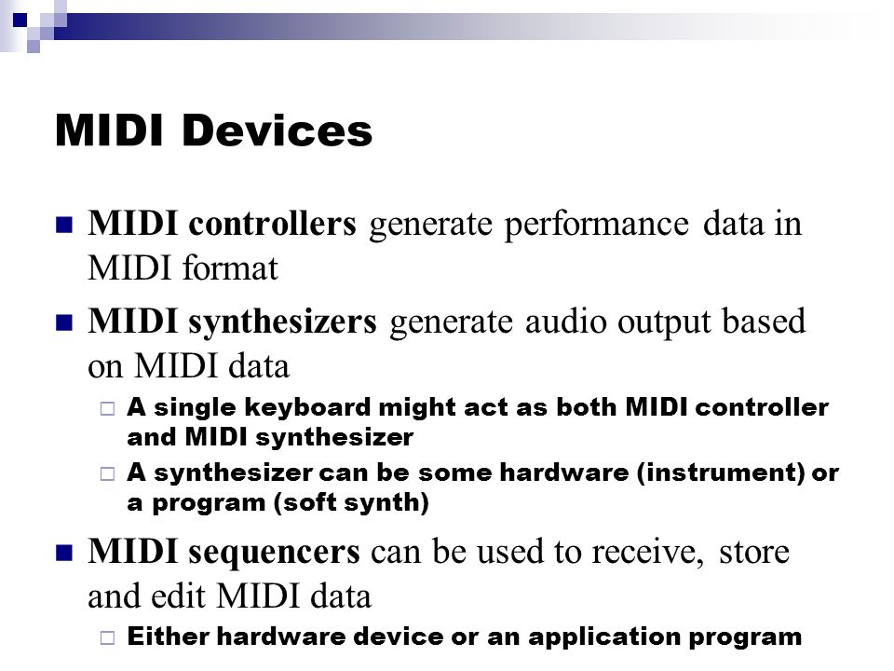

Slide 47
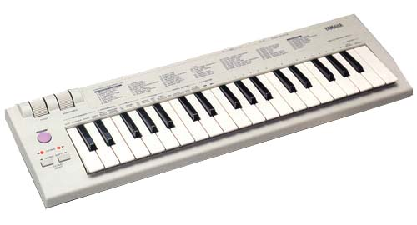
MIDI Hardware
a. Pure Musical Input Devices
Most common: Keyboard
Optional Features
  i. Note Polyphony:
    Nowadays, most keyboard have polyphony (a $200 keyboard made in the Mainland, can have 10 polyphony)
  ii. Touch response
    A keyboard can sense different levels of input pressure

Slide 48
MIDI Hardware
b. Other Musical Input Devices
Keyboard + synthesizer
= keyboard synthesizer
  have real-time audio output
  Some keyboard synthesizers support DSP (Digital Signal Processing)
    Which gives more available effects
    e.g. phaser, chorus
Keyboard + synthesizer + sequencer /sampler/effects processors….
= keyboard workstation
  you can then compose and make music,
  just with a keyboard

Slide 49
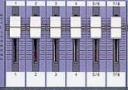

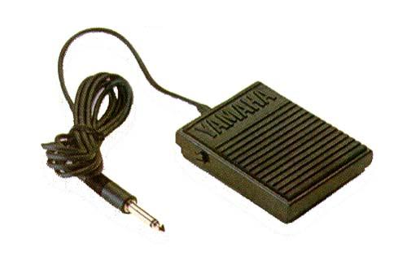
MIDI Hardware
c. Controllers
Numbered controllers
  e.g. volume panel
Continuous Controllers
  You can roll the controller to get a
  particular value
  e.g. modulation wheel
On/Off controllers
  can send two different values
  (e.g. 0/127)
  e.g. foot pedal (sustain pedal)

Slide 50
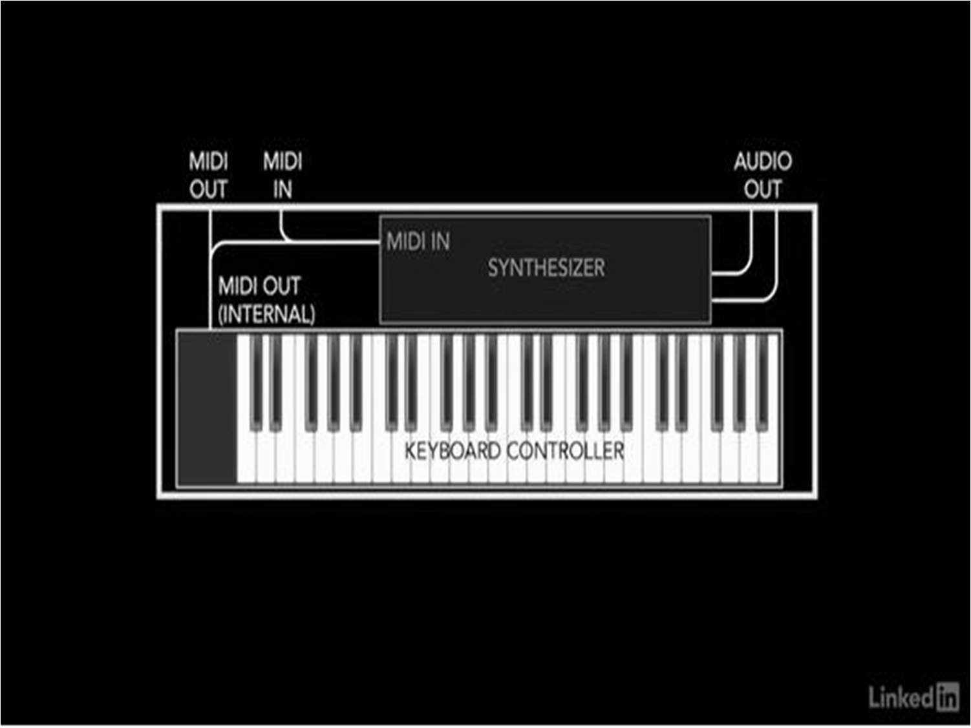

Slide 51

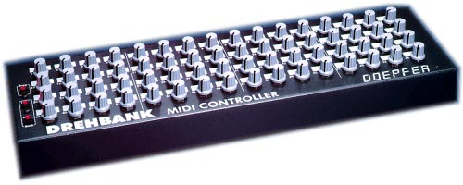
MIDI Hardware
c. Controllers
bidirectional controllers
  it will jump back to the center
  when released
  e.g.. pitch wheel
universal MIDI controller
  Can control all types of control events
  In some products, the panel can synchronize with the software: the panel will move if you adjust parameters in the software.

Slide 52
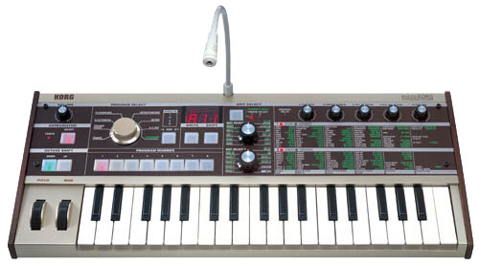
MIDI Hardware
d. Synthesizer
Generates sound from scratch
Method:
  1. Wavetable/direct synthesis.
    store the series of numbers the represent the amplitude values of a waveform, at each sample interval, then recall the stored value to produce sound
  2. frequency modulation (FM) synthesis
    Simple waveforms change the frequencies of other simple waveform, produce a new waveform.
  3. additive synthesis
    add together a number of harmonics at different frequency
  4. subtractive synthesis
    starts with a waveform that is already rich in harmonics, then filter out unwanted harmonics to produce a desired sound
  5, phase distortion
    a simple waveform is altered to produce a more complex one

Slide 53
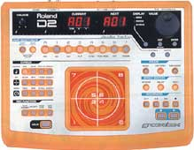
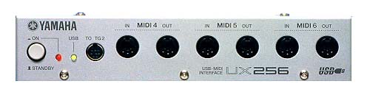
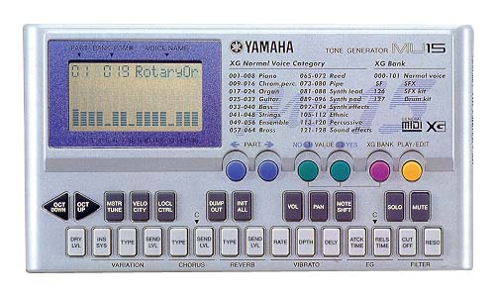
MIDI Hardware
e. Sequencer
  replay a sequence of MIDI messages
f. MIDI interface
  connect a group of MIDI devices together
g. sound sampler
  record sound, then replay it on request
  Can perform transposition shift of one base sample, to produce different pitches
  Can take average
  of several samples,
  then produce a
  timbre interpolated
  output sound

Slide 54
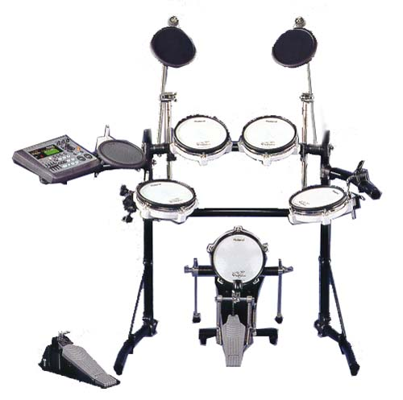
MIDI Hardware
Other possible pure input MIDI I/O devices:
  Guitar, Flute, Violin, Drumset

Slide 55
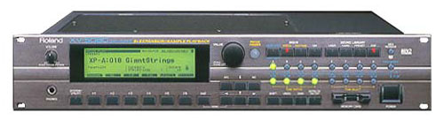
MIDI Software
a. Software Sampler
e.g. Gigastudio, Kontakt
P.S. now, most studio use software samplers for pop song, instead of hardware sampler.
WHY?
Since it is more economical, and more efficient to update
For example, the hardware sampler Roland XV5080, cost HK$17500.
Its additional sound sample sub-cards are very expensive ($2000 for 100 samples)
Also, the model of samplers are updated very quickly. For example, the last model XV5050 already cannot use the latest Roland SRX sub-card already

Slide 56
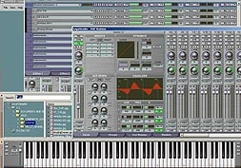
MIDI Software
a. Software Samplers
However, for example, Gigastudio costs around $4000 for the software
A 3GB of additional sound samples only costs around HK$1000.
All new samples are compatible to latest version since version 2.5
As you can hear in the later section, you will find that the software synthesizer is actually performing MUCH BETTER than hardware synthesizer OF SIMILAR PRICE RANGE.

Slide 57
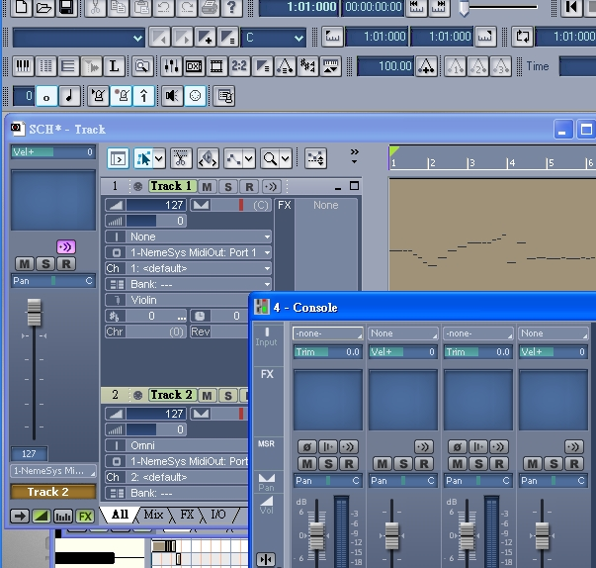
MIDI Software
b. Recording software
e.g cakewalk sonar, cool edit pro , CUbase, logic, protools
Much more efficient than using tape recording
Can redo recording process
Can easily do editing
Also allows effects (reverb, echo, etc)

Slide 58
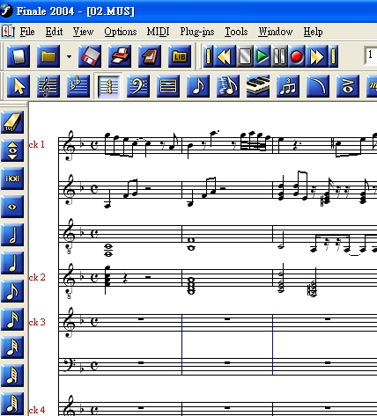
MIDI Software
c. Score editor :
e.g. Finale, cakewalk overture
you can “listen to the score” by playback option
neat and tidy
can do transposition/chord identification….etc,
more easily than using handwritten score
Can input a score with real instruments,
then tidy it up by quantization

Slide 59
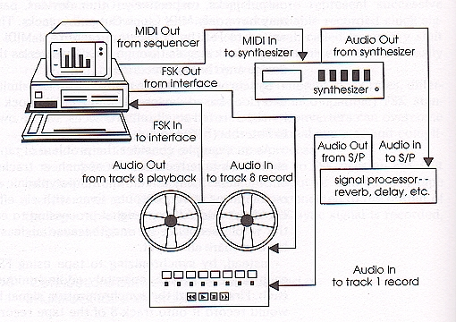
Example of a recording process
This is a “Daisy-chain network”, where device are connected serially

Slide 60

Example of Comparing different sampler performance
You can hear the difference between different synthesizers/modules, for playing the same MIDI file.
1. Yamaha PCI FM Synthesizer
2. Roland XV-5050 (JV series)
3. Gigastudio
And one more demo for Gigastudio:

Slide 61
Applications of MIDI
1. Studio Production
  recording, playback, cut-and-splice editing
  creative control/effect can be added
2. Making score
  with score editing software, MIDI is excellent in making score
  some MIDI software provide function of auto accompaniment/intelligent chord arrangement
3. Learning
  You can write a MIDI orchestra, who are always eager to practice with you!

Slide 62
Applications of MIDI
4. Commercial products
  mobile phone ring tones, music box music…..
5. Musical Analysis
  MIDI has detailed parameters for every input note
  It is useful for doing research
  For example, a pianist can input his performance with a MIDI keyboard, then we can analyze his performance style by the parameters

Slide 63
